Slide 1



Coffee Shop Sales Analysis Dashboard

Slide 2


Start Your Day With Coffee
The main objective of this project is to Analyze retail sales data to gain actionable insights that will enhance the performance of the Coffee Shop.

Slide 3
Recommended Analysis
How do sales vary by day of the week and hour of the day?
Are there any peak times for sales activity?
What is the total sales revenue foreach month? How do sales vary across different store locations?
what is the average price/order per person.
Which products are the best selling in terms of quantity and revenue?-
How do sales vary by product category and type?

Slide 4

How do sales vary by day of the week and hour of the day?
Sales tend to peak during Monday, Thursday, Friday and Mornings, indicating higher consumer activity during leisure time.

Slide 5
Are there any peak times for sales activity?
Yes, there is a peak sales activity observed typically in the morning between 9 AM and 10 AM.

Slide 6
What is the total sales revenue for each month?
The total sales revenue varies month by month, for each month is as follows:
January: $81,677.74
February: $76,145.19
March: $98,834.68
April: $118,941.08
May: $156,727.76
June: $166,485.88

Slide 7
How do sales vary across different store locations?
Sales across different store locations exhibit slight variations:
Astoria: $232,243.91
Hell's Kitchen: $236,511.17
Lower Manhattan: $230,057.25
These figures indicate that Hell's Kitchen has the highest sales among the listed locations, followed closely by Astoria, while Lower Manhattan has slightly lower sales.

Slide 8
What is the average price/order per person?
The average price per order per person is $4.69 This figure represents the average amount spent by each customer per order, providing valuable insight into the spending behavior of the clientele.
4.69
Average Bill Per Person

Slide 9
Which products are the best selling in terms of quantity and revenue?
This Top 5 Products are the best-selling products in terms of quantity and revenue are as follows:
1. Barista Espresso:
Revenue : $91,406.20
Quantity: 16403
2. Brewed Black tea:
Revenue: $47,932.00
Quantity: 11350
3. Brewed Chai tea:
Revenue : $77,081.95
Quantity: 17183
4. Gourmet brewed coffee:
Revenue : $70,034.60
Quantity: 16912
5. Hot chocolate
Revenue : $72,416.00
Quantity: 11468
These rankings provide insight into both the top-selling products based on revenue and quantity. While Barista Espresso generates the highest revenue, Brewed Chai tea leads in terms of quantity sold.

Slide 10
How do sales vary by product category and type?
The best-selling Top 5 products according to their Product Type are as follows:
Product Category: Coffee:
Product Type: Barista Espresso:
Sale: $91,406.20
Product Type: Gourmet brewed coffee
Sale: $70,034.60
Product Category: Tea:
Product Type: Brewed Black tea
Sale: $47,932.00
Product Type: Brewed Chai tea
Sale: $77,081.95
Product Category : Drinking Chocolate:
Product Type: Hot chocolate
Sale: $72,416.00
This breakdown illustrates the sales distribution across different product categories and types. Tea products, particularly Brewed Chai tea, contribute significantly to sales, followed closely by Coffee products such as Barista Espresso and Gourmet brewed coffee. Additionally, Hot chocolate represents a notable portion of sales in the Drinking Chocolate category.

Slide 11
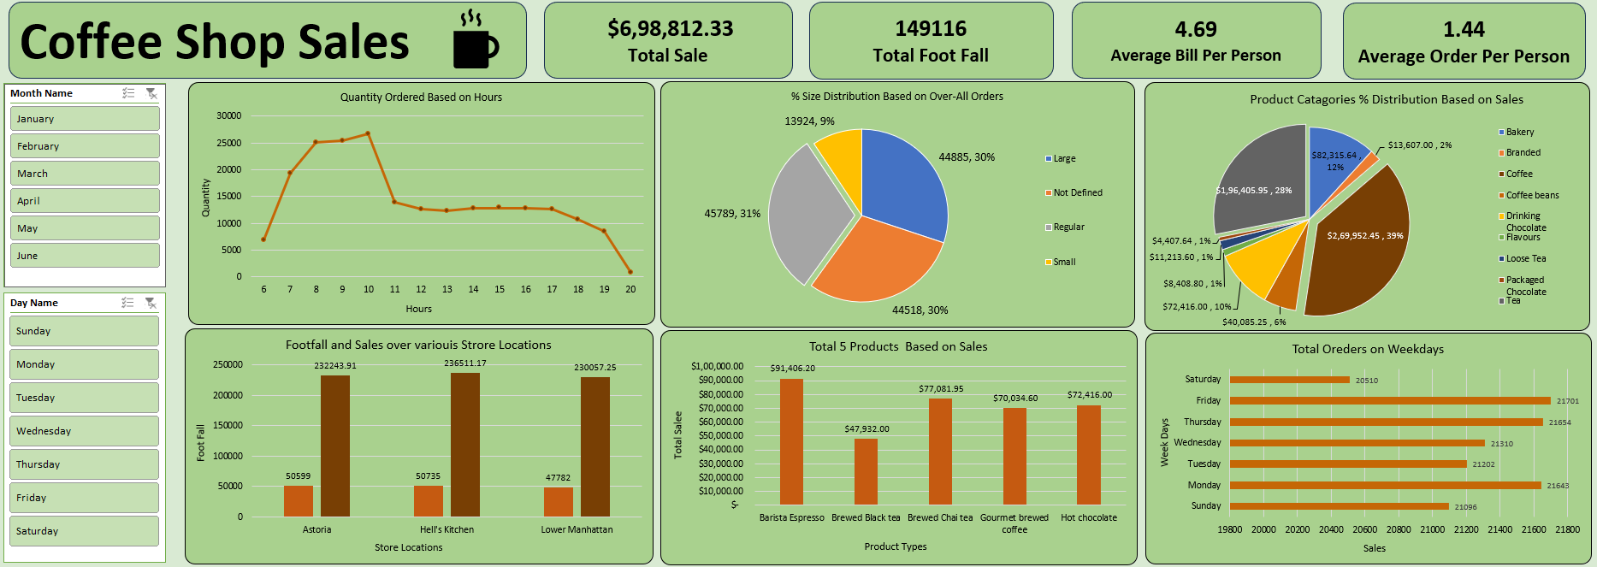
Final Excel Dashboard

Slide 12

Thank you
Rahul S Ravade
rahulravade485@gmail.com
GitHub Link
Linkedin Link

